Slide 1
Training data-efficient image transformers & distillation through attention
李晓宇
2021.3.16

Slide 2
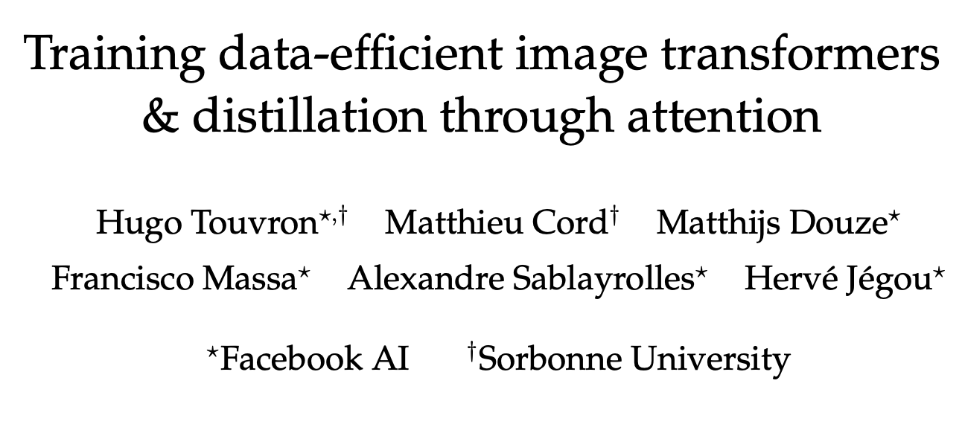
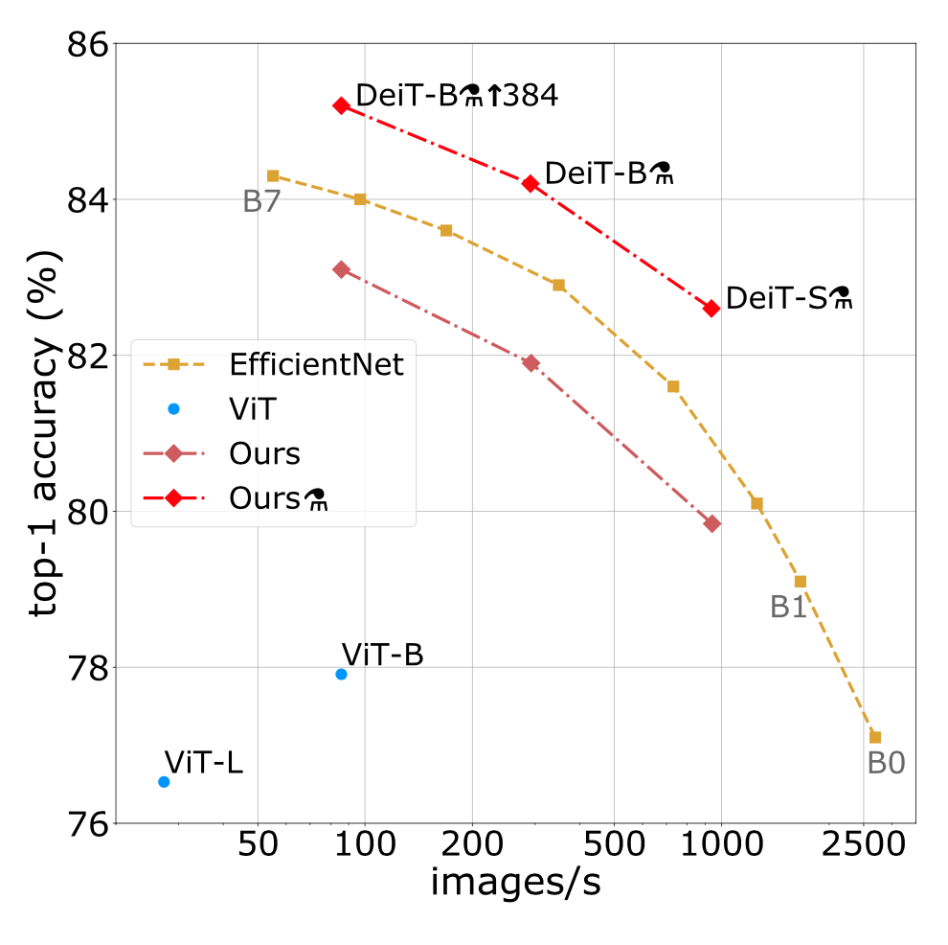
https://github.com/facebookresearch/deit

Slide 3
Background
Motivated by the success of attention-based models in Natural Language Processing, there has been increasing interest in architectures leveraging attention mechanisms within convnets. (hybrid architecture)
The vision transformer (ViT) presents excellent results with transformers trained with a large private labelled image dataset (JFT-300M (not released yet by Google), 300 millions images).
ViT paper concludes that - transformers “do not generalize well when trained on insufficient amounts of data”, and the training of these models involved extensive computing resources.

Slide 4
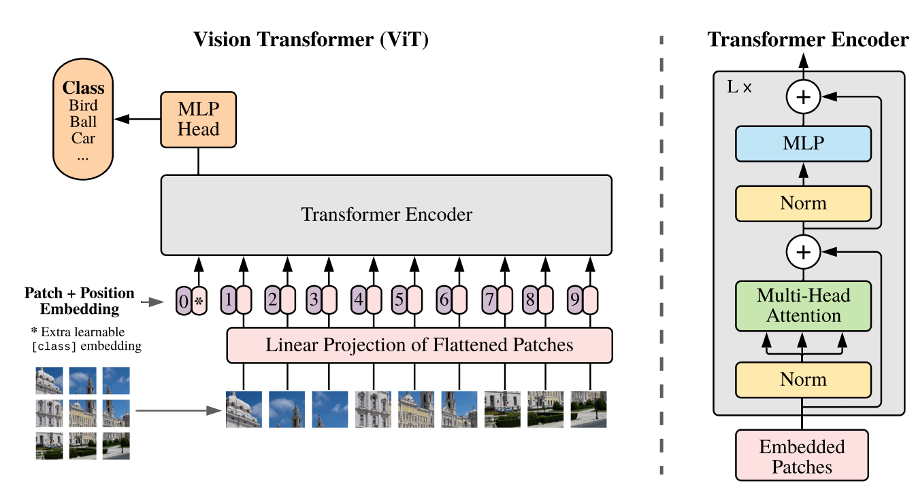
Vision Transformer

Slide 5


Normal Distillation
Soft distillation
Hard-label distillation
Note that the hard label associated with the teacher may change depending on the specific data augmentation.

Slide 6
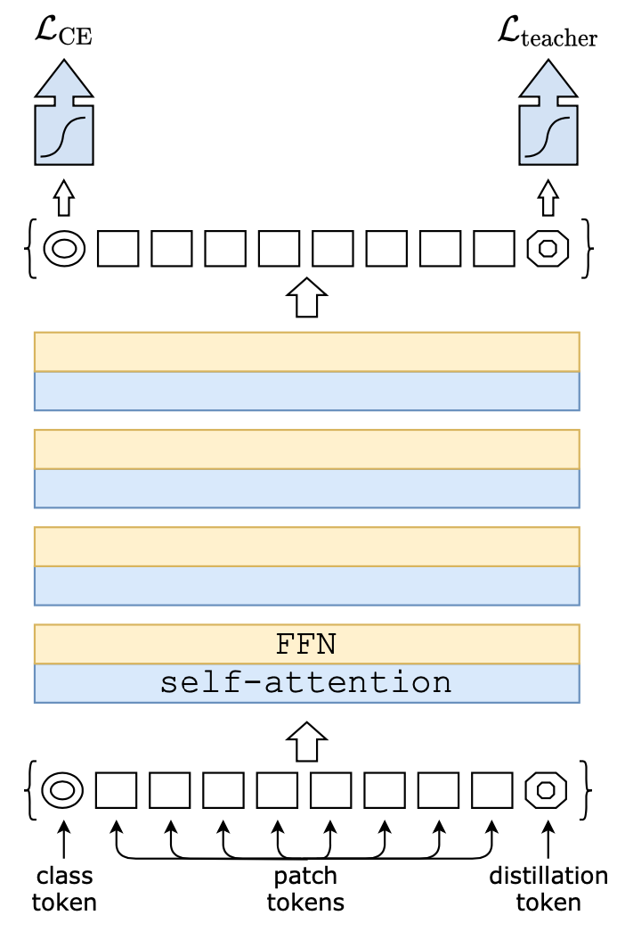
Proposed Distillation
Output = Softmax(class_token_result, distillation_token_result)

Slide 7
Proposed Distillation
Cos(class_token, distillation_token)=0.93
Cos(class_token, distillation_token)=0.06

Slide 8
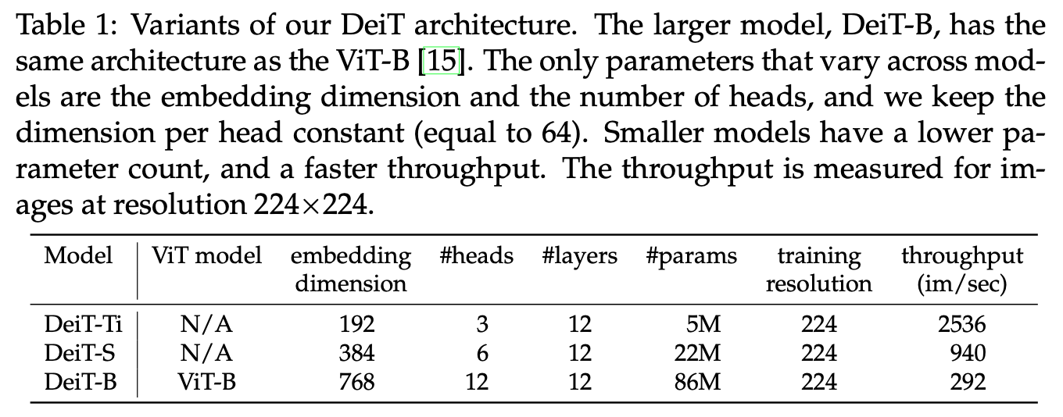
DeiT models

Slide 9
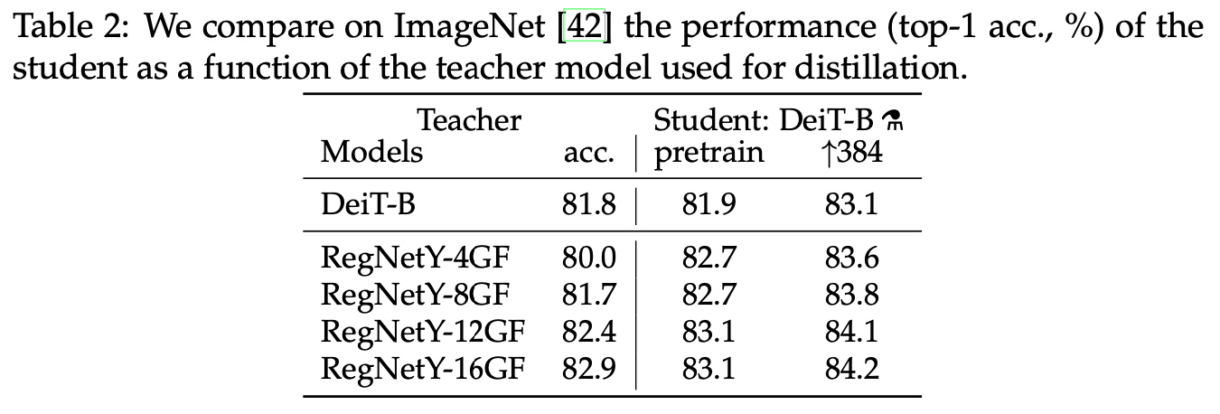
Experiments – teacher model

Slide 10
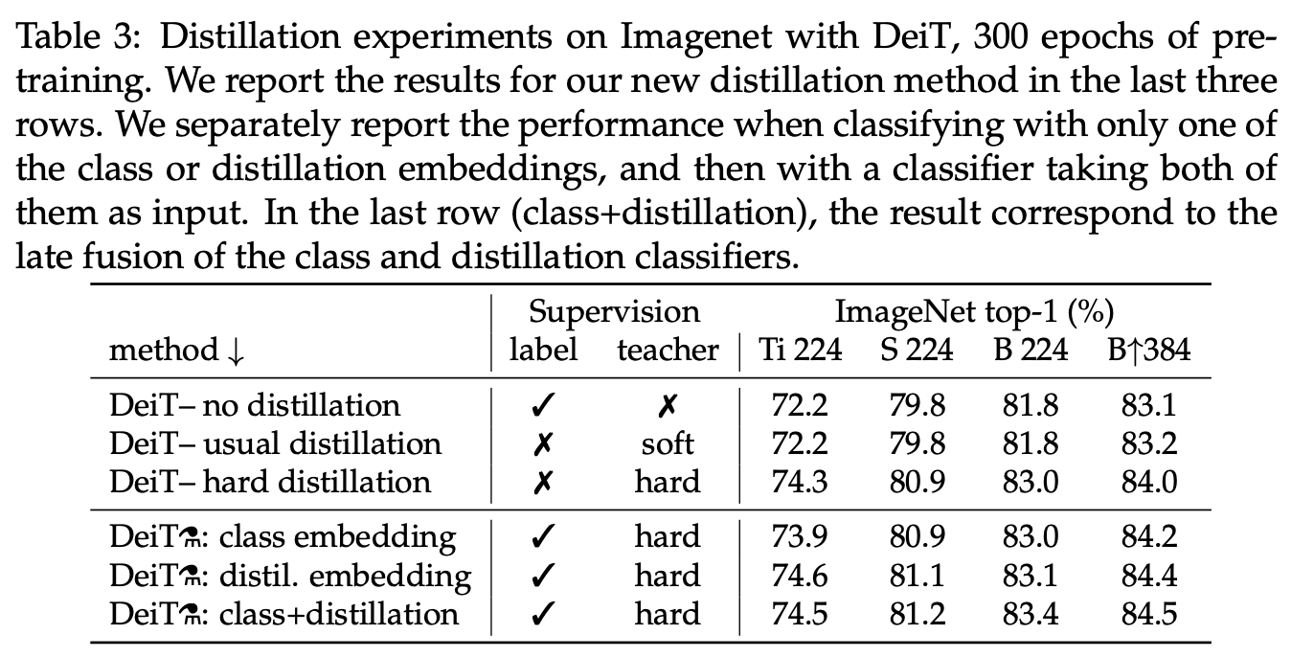
Experiments - Distillation

Slide 11
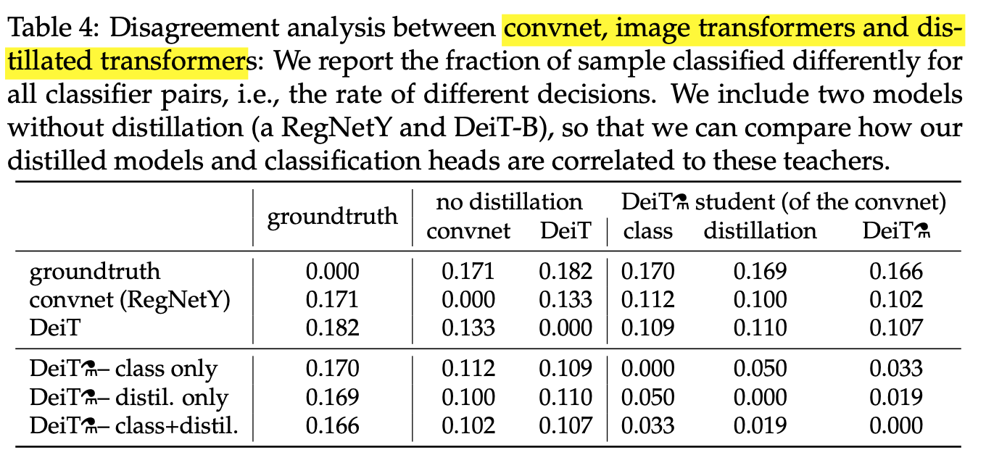
Experiments

Slide 12
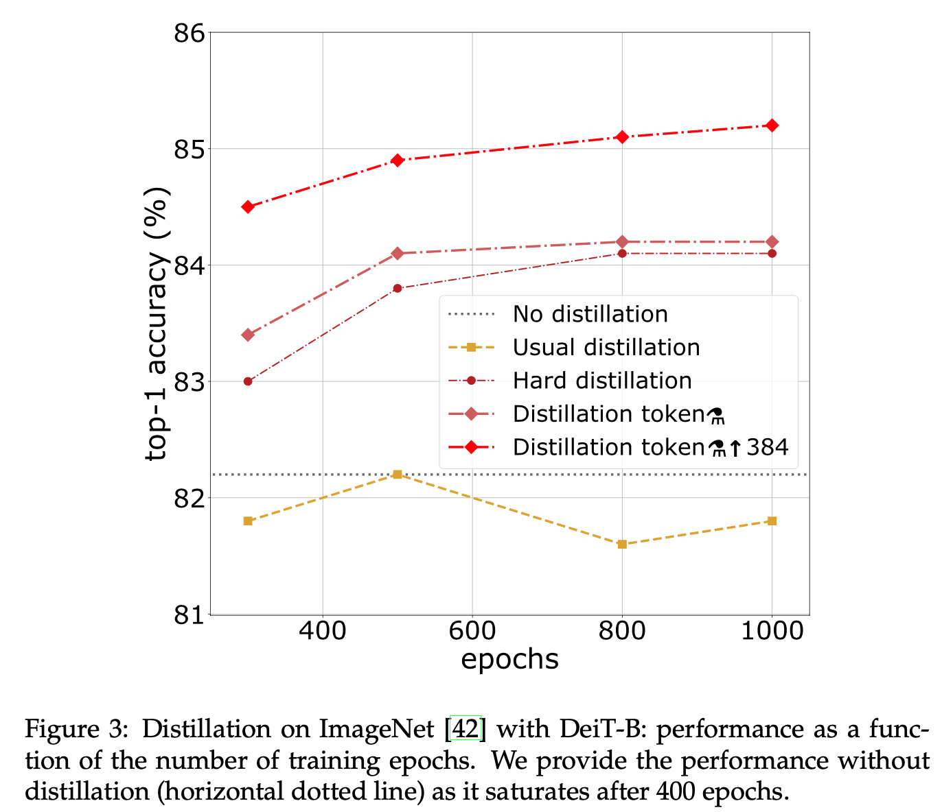
Experiments

Slide 13
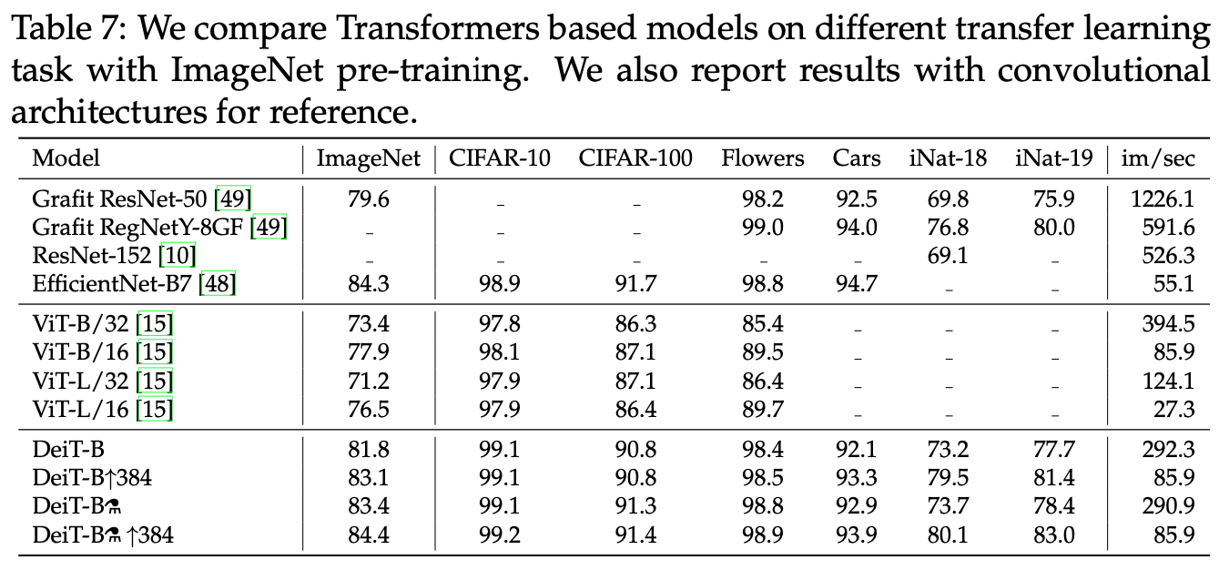
Experiments – transfer learning

Slide 14
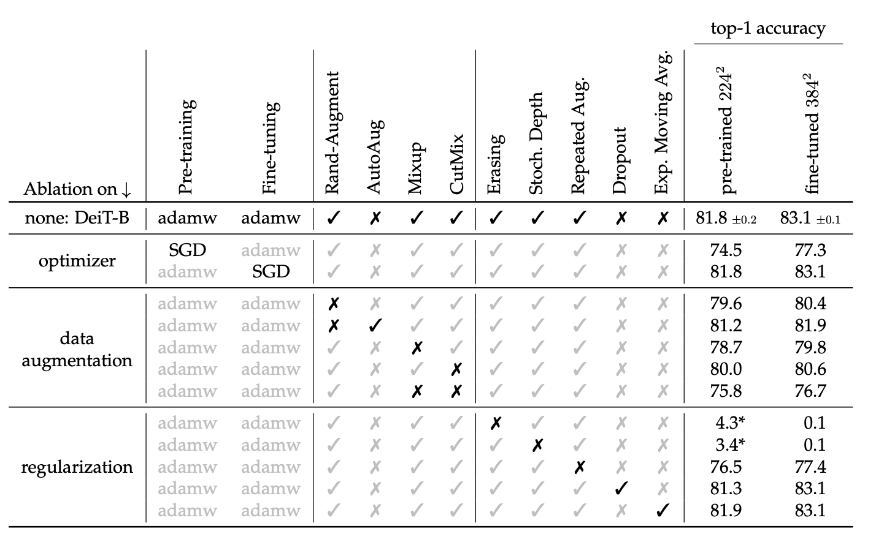
Experiments – Ablation study

